Slide 1



Te Hononga Taiao
The Nature Connection
Trails & Tots PSP Curious Minds Project 2024

Slide 2
Contents

Slide 3

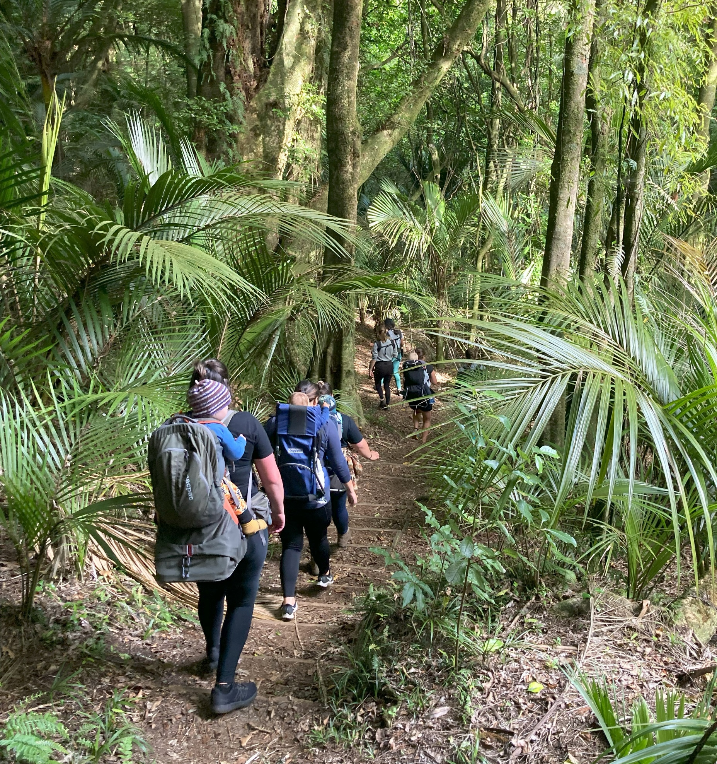
About Trails & Tots
Trails & Tots provides nature-based meet ups, workshops and events for the Taranaki parenting community. Trails & Tots kaupapa is all about helping whānau to connect with local taiao, build community and reap the benefits of time outdoors.
Since starting up in early 2023, Trails & Tots has:
- run 126 nature-based meetups/events
- had over 363 different whānau participate
- had 2500+ individual participants across all events*
- developed a free gear library to reduce the barriers to accessing time outdoors with children for Taranaki whānau
(*inclusive of parents and children, including repeat participants)
About PSP Curious Minds
Curious Minds Taranaki is a Participatory Science Platform (PSP) delivered locally by Venture Taranaki in collaboration with Taranaki Regional Council and funded by the Ministry of Business, Innovation and Employment (MBIE).
Venture Taranaki provides funding, support, and expertise to community groups to undertake collaborative, locally relevant research, tackling problems and questions that matter to them.
Notes:
Put *disclaimer note as a supscript 1/2/3 etc then put a notes page after end of slides,
Split this slide in two – bold and colourful standard words/acheivements

Slide 4
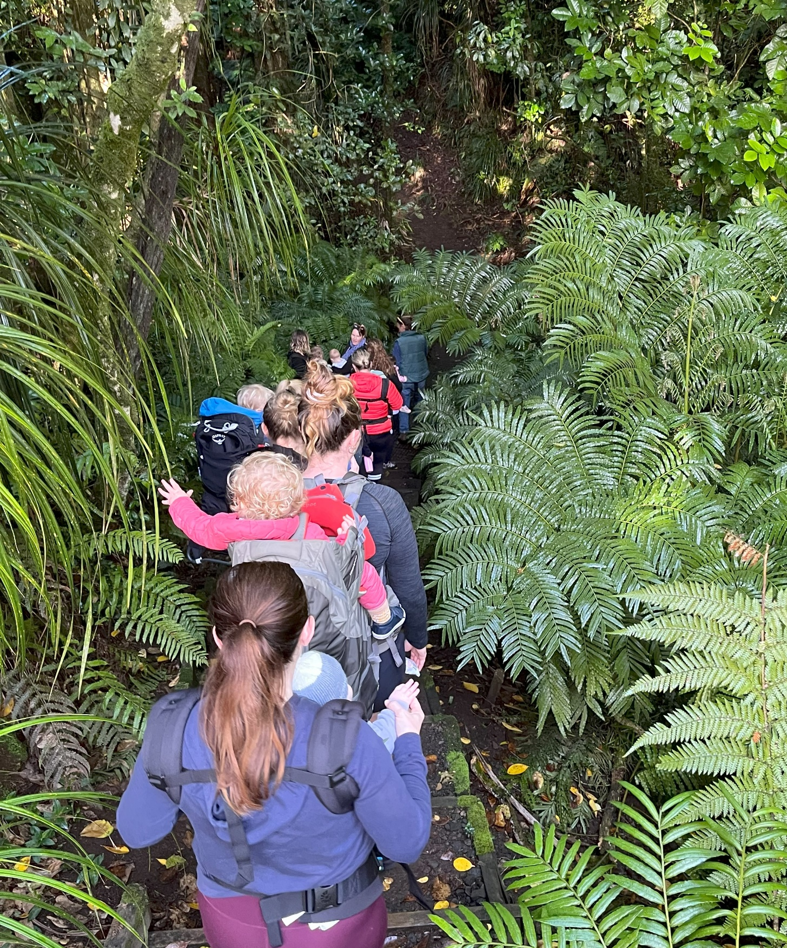
Te Hononga Taiao
Project Goals & Driving Questions
How does participation in nature-based programs affect parental health and wellbeing?
How does an outdoor community support or nourish an individual’s transition in to
parenthood?
What barriers exist that prevent new parents from getting outdoors with their pepi?
What barriers exist that prevent new parents from participating in nature-based
programs with their pepi/tamariki?
What benefits (if any) do new parents get from participating in nature-based programs?
Does participation in nature-based programs build stronger care for, and connection between, new parents/whānau and local taiao/nature?
What connections are formed for new parents through participation in nature-based programs; connection with others, with nature, with their child(ren), with their own wellness, etc.

Slide 5
Methods – Citizen Science
1) Community Focus Groups n = 21
5x Small Focus Groups held to discuss personal experience(s) around parenting, postpartum and outdoor recreation with and without tamariki. These conversations worked to shape and grow the surveys, while also contributing to the findings through transcript thematic analysis.
2) In Meet Up Surveys n = 48
A self-report survey given to Trails & Tots participants BEFORE and AFTER hiking meet ups* examining changes in feelings of:
- contentment - connectedness to nature - energy levels/rested
- sociability - being attuned to one’s own child(ren)
*Participants of Trails & Tots have their child(ren) with them during the nature-based programs.
3) Nation-wide Survey n = 226
An online survey open to any and all parents across Aotearoa with tamariki under the age of 10yrs of age. The survey was open for two weeks and was advertised through social media, physical posters, and online advertising.
Notes:
Each bullet, new page with a photo/image to show visually?
Superscipt on the first n= with a note explaining the concept in notes section

Slide 6
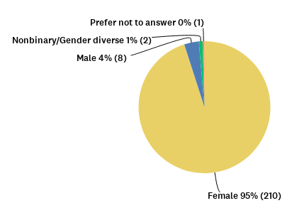
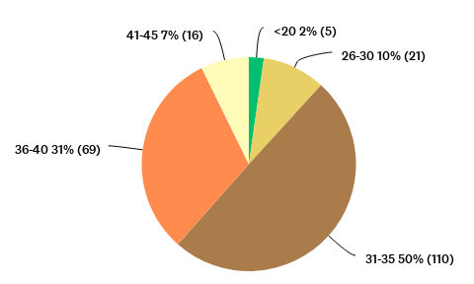
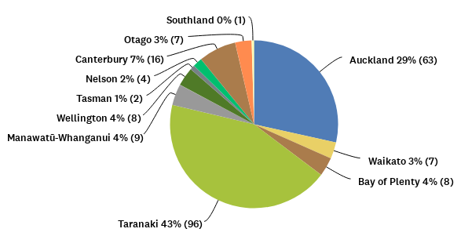
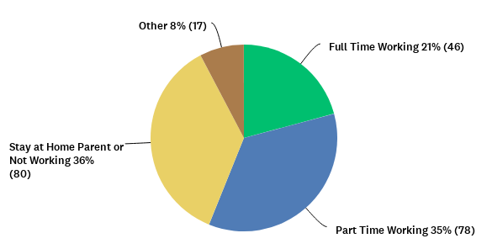
Nation-Wide Survey
Respondents
Gender
Age of Respondents
n = 226
43% from Taranaki
95% Female (reflects numbers of those taking parental leave/attending parent-child groups, and following Trails & Tots on social media).
48% had 2 children, 38% had 1 child, 13% had 3+ children
83% live Urban; 17% live Rural
Working Status: Full time 21%; Part Time 35%; SAHP or Not Working 36%
*It is noted that an OIA inquiry on parental leave, showed 97% of primary care givers are female
Region of Residence
Working Status
Notes:
Use better graph types and then you wont need the text? Possibly highlight a couple of key points
Will both this and the next slide be important do you think? Is a lot of it fairly common sense and better to pull out some surprising or interesting aspects of respondents/demographics?

Slide 7
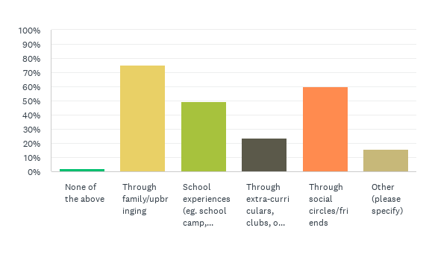
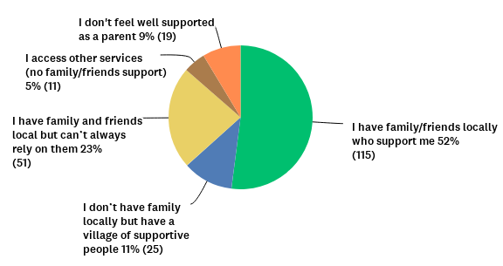
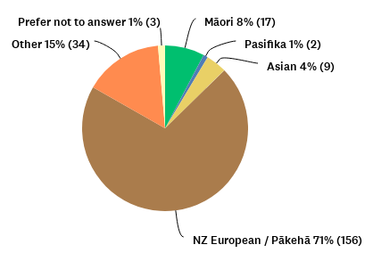
Nation-Wide Survey
Respondents
Q: If you feel that spending time in the outdoors is important for your health and well-being, please tell us how you came to feel connected to time outdoors.
Participants were also asked to use a scale of 0-100 to respond to the following statements:
I feel that spending time in the outdoors is important to my overall health and well-being. Average response = 92
Would you describe yourself as an outdoorsy person? Average response = 68
The term “outdoors” was pre-defined for respondents as: “any activities that you do with or without your children (a range of examples listed). We would like you to answer with a general idea of what outdoors means to you, regardless of the specific activity or intensity of activity.”
Q: Tell us about your support network as a parent
Ethnicity
Notes:
Chart to the right – simplify the text “not well supported”, “family friends support”, “non-family/friends support” etc

Slide 8
Research Findings – Answer to our questions
Q: How does participation in nature-based programs affect parental health and wellbeing?
Findings: Participating in nature-based programs has a number of benefits to parental health and wellbeing. Commonly reported benefits around health include:
Time in nature with child (90.5%)
Improved feelings of connection with nature (76.2%)
Exercise and fitness (68.2%)
Community and support within the group (63.5%)
Reduced feelings of stress (39.7%)
*Statistics are from 2024 Trails & Tots Participants “In Meet Up Survey”
Participants report feeling more relaxed, rested, content, connected to nature, attuned to child and sociable after spending time in a nature-based program.
100% of surveyed participants reported improved feelings of wellbeing in one or more area after participating in a nature-based session with their child(ren).
Spending time exercising outdoors supports postpartum recovery, physical and mental health, alongside a decrease in stress and more self-regulation (SOURCES).
Notes:
Disclaimer/note to notes page
Maybe just keep your highlighted bullet as it broadly encapsulates the other two and is clear

Slide 9
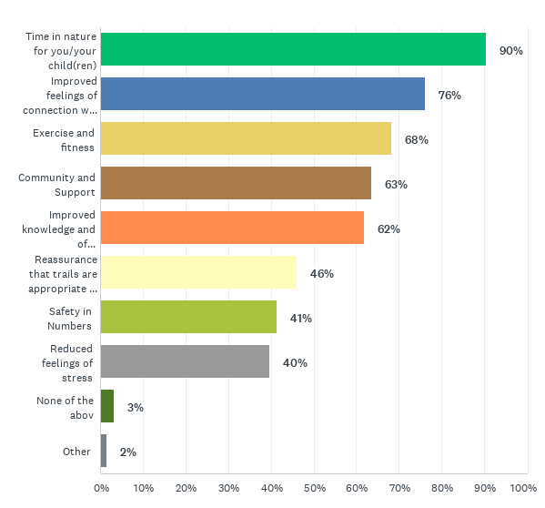
Research Findings – Answer to our questions
Q: How does an outdoor community support or nourish an individual’s transition in to parenthood?
Findings:
Trails & Tots provides:
enjoyable experiences in nature for parents and children
a community of like-minded parents
a more flexible type of social interaction than traditional parenting groups
safety in numbers while outside
increased knowledge of local tracks
motivation during the postpartum period to get outdoors, socialize and be physically active
improved confidence in going outdoors with children.
Reported benefits from attending Trails & Tots Nature-Based meet ups
ith your outdoor environment
for you and your child
Notes:
Chart could answer this question if clearer/more engaging – make the chart wording match the finding?

Slide 10
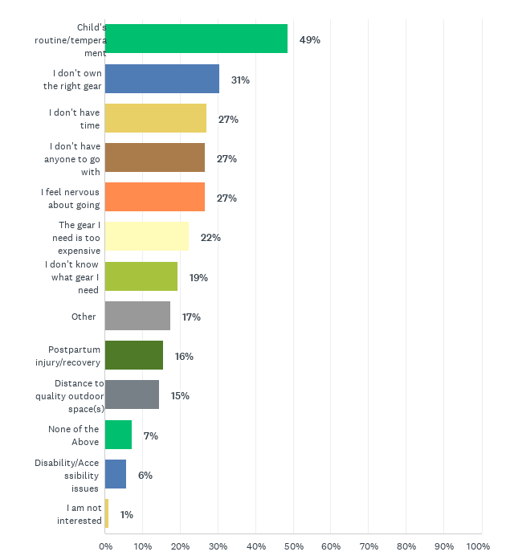
Research Findings – Answer to our questions
Q: What barriers exist that prevent new parents from getting outdoors with their pepi?
Findings: The main barriers for parents to spend time outdoors are:
Childrens’ routines and temperament (48.5%)
Not owning the right gear (30.58%)
Not having time (27.18%)
Not having anyone to go with (26.7%)
Feeling nervous about going (26.7%)
A key barrier was lack of opportunities to do so in a group/with others.
Barriers tend to differ depending on socio-economic status and self-perceived levels of outdoorsy-ness and experience in outdoor recreation before having children.
Parent-perceived
barriers to
spending time outdoors
with child(ren)
(could select multiple)
Notes:
Again the chart could do the talking

Slide 11
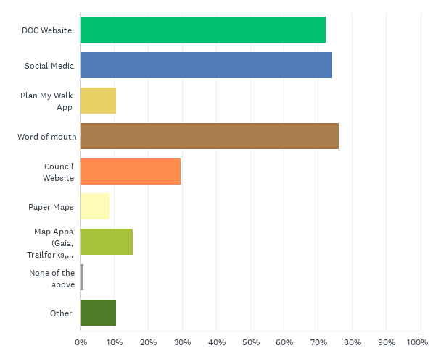
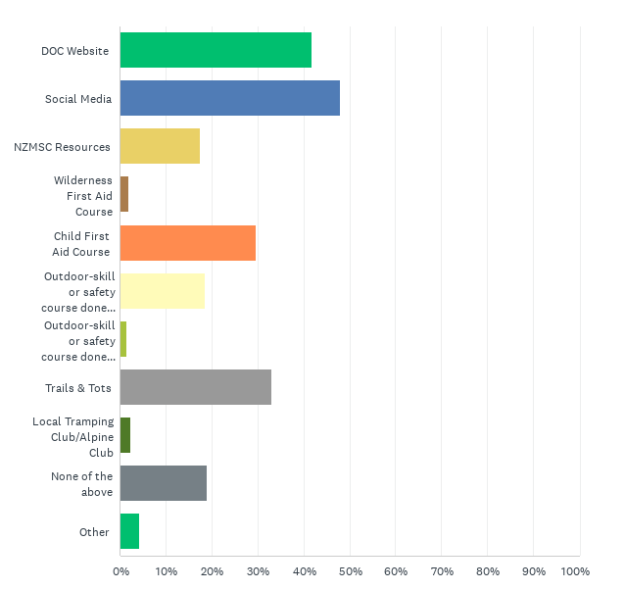
Currently, parents predominantly turn to social media or word of mouth to determine which tracks/outdoor spaces are suitable for spending time outdoors with their child(ren) (see below).
Tools and resources that parents use to find information about what tracks to access with their child(ren).
Tools and resources that parents utilize to gain information about outdoor-safety with children.
Outdoor Skill or Safety course done BEFORE having kids
Outdoor Skill or Safety course done AFTER having kids

Slide 12
Research Findings – Answer to our questions
Q: What barriers exist that prevent new parents from participating in nature-based
programs with their pepi/tamariki?
Findings:
Only 7% of parents reported being provided with information about the benefits of spending time outdoors, tips on safety or information on where to go when recreating outdoors with children after having a child(ren).
Yet 85% stated they would have liked to receive information/support about the benefits of time outdoors with kids, tips on safety or information on where to go when recreating outdoors with children.
74% of respondents said that they would like to access more organised outdoor services specific to new parents.
Potentially, the biggest hurdle to participating in a parent-centred, nature-based program is that there are so few parent-centred, nature-based programs currently existing across Aotearoa. As of October 2024:
16x Nature Playgroups found that run across Aotearoa (most in Auckland, Christchurch and Wellington)
5x Parent & Child hiking/nature-education groups found across Aotearoa (Waikato, Northland, Dunedin, Christchurch & Taranaki). Trails & Tots was the first of these groups, and has offered mentorship in the other groups establishing.
limited info agailable\
Doc concession
Notes:
Biggest hurdle in BOLD at bottom, then list reasons (in bried below or to side) – funding/liability&risk/poor track information/close proximity tracks/DOC concession/facilitor skillset
Bottom two bullets can be moved to next slide which can be moved to back
Generally shorten up the text – first bullet could be:
New parents provided with information describing benefits and how to recreate outdoors safely = 7%
Second bullet could be
85% stated they would have liked to receive this information
Key finding, simple and bold in bottom

Slide 13
Why don’t more nature-based programs exist for parents in Aotearoa?
Our findings show that nature-based programs have significant health and wellbeing benefits for parents. There is arguably substantial evidence that those with the greatest barriers to spending time outdoors, are the ones who could benefit the most from participation in nature-based programs. The barrier of cost/affordability and access to gear means Trails & Tots/similar nature-based programs should stay koha-based or free, in order to provide and inclusive and accessible program. This means programs require funding for coordination, equipment, facilitation, gear library maintenance & growth, etc.
Liability and risk management systems need to be in place
Limited information available catered to whanau/parents around tracks and outdoor spaces (eg. Identifying specific hazards as they would relate to having young Tamariki on foot.)
Importance of close-proximity tracks AND awareness of said tracks, to reduce drive-time for parents who feel a barrier is routine/temperament or child not liking car time
For Trails & Tots/similar businesses to charge a fee, they must pay concession to use land, which makes cost prohibitive. DOC and Council would benefit from waiving this concession, as programs provide education, health and wellbeing, conservation awareness, and community benefits, as well as more people aware-of and using tracks and greenspace.
Requires unique skillset to set up nature-based programs catered to parents within each region; need substantial regional awareness, understanding of parent-needs, marketing capabilities/reach, support of local GPs/midwives/other parent organisations, risk-management skills to support “meet up” style group.
Notes:
Move this slide to bottom – link it from slide above

Slide 14
Barriers Preventing Parents from Getting Outdoors with their Children continued
Those who had attended Trails & Tots or other Nature Playgroups reported fewer overall barriers
to spending time outdoors with their child(ren), compared to those who had not attended any whānau-centred nature based programs. Some highlights in the table below.
 | Has attended Trails & Tots and/or Other Nature Playgroup | Never attended parent/child Nature-Based Program
I know where to find reliable information about what tracks would suit me and my child(ren) for outdoor activities | 62% | 49%
I feel confident in my knowledge on safety in the outdoors | 58% | 55%
I feel safe when I spend time outdoors with my child(ren) | 79% | 74%
Perceived, self-reported level of “outdoorsy-ness” (average for each group) Scale was 0-100 | 76 | 71
Perceived importance of time outdoors being an important factor for personal health and wellbeing (average for each group) Scale was 0-100 | 94 | 92
Notes:
Keep the heading of the previous slide if its related (if its absolutely needed)

Slide 15
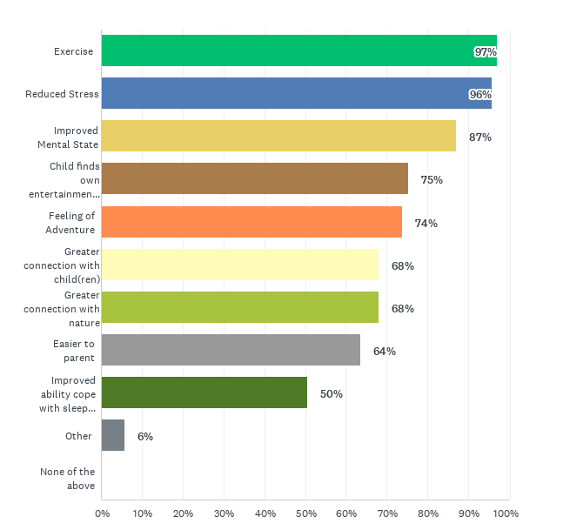
Research Findings – Answer to our questions
Q: What benefits (if any) do new parents get from participating in nature-based programs?
Findings: Non-health and wellbeing related benefits of attending nature-based programs include:
Improved feelings of connection with outdoor environment (76%)
Improved knowledge of the region and its trails/ outdoor spaces (61.9%)
Reassurance that trails are appropriate for me and my children (46%)
Comfort and safety in numbers (41.3%)
*The above statistics are from Trails & Tots participant respondents, and refers to benefits received from attending Trails & Tots program. The figure (right) are perceived benefits of time outdoors as reported by all respondents to the Aotearoa-wide survey.
Perceived benefits for parents from spending time outdoors with their child(ren)
Notes:
Chart could speak for itself if clearer

Slide 16
Research Findings – Answer to our questions
Q: Does participation in nature-based programs build stronger care for, and connection between, new parents/whānau and local taiao/nature?
Findings:
Improved feelings of connection with nature (76.2%)
Improved knowledge and awareness of region’s trails/outdoor space (67%)
Most people reported feeling less adventurous, taking fewer risks and doing fewer, different outdoor activities than before having children. However, the feeling of connectedness with nature increased after having children.
“I feel like since having kids I am more connected with nature in that we need to be in it more to keep us all sane and healthy - the need to be in nature feels much stronger post children perhaps from needing to get out of the house, education and fun and energy for kids but also mental health”

Slide 17
Research Findings – Answer to our questions
Q: What connections are formed for new parents through participation in nature-based programs; connection with others, with nature, with their child(ren), with their own wellness, etc.
Findings:
Before and After surveys at Trails and Tots meetups showed that, in all cases, participants increased their perception of feeling relaxed, rested, content, connected to nature, attuned to child and/or sociable.
“Taking time to walk, even in urban green spaces, was a really important part of my postpartum experience. It made the adjustment easier, less stressful and created common enjoying for my children and I.“
“I had to really readjust my expectations of what I could do physically compared to before having my son. I've had to slow down which has both been wonderful & challenging.”
“For me, since having kids it’s really confirmed how important nature is for my sanity and my children’s sanity. It’s a necessity rather than something I enjoy.”
“I’ve actually started giving more importance to outdoors since having a kid”
Notes:
Use one quote? Max two?

Slide 18
Effects of Nature-Based Programs on Parental Health & Wellbeing
Pie Chart with Benefits of time outdoors
Notes to supplement
Special notes related to stress scale? Eg. Those facing more stress and anxiety less likely to report feeling benefits of fitness, social and more likely to report benefits of safety, information, community.
Parents with an infant, regardless of number of total children, are more stressed (Cite additional source with stats on parent cortisol levels)
Notes:
Put conclusions in title maybe? Show in contents – different font or something to differentaiate from findings

Slide 19
What Support is Needed?
Recommendations and Next Steps
1) Formal, trustworthy track information
People who report that they want to receive more tips and information about the benefits of spending time outdoors with their children in organised groups, are likely to feel less confident, prepared or safe going outdoors compared to others.
Having the knowledge about what tracks are suitable provides:
- Confidence - Safety - Healthy risk management skills - Preparedness
Trails & Tots participants rely more on Trails & Tots content than on “official” resources like DOC.
Social media was the most relied on sources for information around outdoor safety (over DOC, NZ MSC, Child First Aid Courses, etc.
20% of respondents said they relied on “none of the above” for information around safety and preparedness for outdoor recreating with their child(ren).
Child temperament & routine is reported as one of the greatest barriers to getting outdoors. The unique nature of parenting and range of abilities/temperament in young children, means that having objective, informative information around tracks, outdoor spaces, etc. is essential to lessen the mental load for parents, and improve feelings of confidence, preparedness and safety before recreating outdoors with children.
Notes:
Same note as before.
One line for each
Is there an action? Or is recommendation/next steps not the right word. Is this just a conclusion?

Slide 20
What Support is Needed?
Recommendations and Next Steps 2
2) Information about gear and what is needed to go outdoors
Real stories to connect with. People benefit from hearing stories from other whānau around what outdoor “adventures” with children can look like, including learning from others about what gear works for tamarki at what ages/stages. This is well supported by nature-based programs and community.
Parents also need better understanding around what gear is necessary, paired with appropriate safety and risk management information.
Example: You do not NEED a top of the line pack, but you DO need wet weather layers.
Notes:
One liners

Slide 21
What Support is Needed?
Recommendations and Next Steps 3
3) Postpartum wellbeing support connecting to the outdoors
Greater awareness of the benefits of spending time outdoors with their children, especially in early postpartum. People knowing about this might mean they do it more often.
Information and normalization of different ways to “be outdoors” with/without children
(eg. Does not have to be a strenuous hike or multi-day trip).
In the early postpartum period, some reported feeling insecure and anxious about going outside with their children. For this group, more support is needed to encourage and promote the benefits of being outdoors.
People reporting more stress are less likely to know about options to going outdoors with their children, and are those who would benefit most from these activities.
Given the clear implications of spending time outdoors with their young children, it is vital that organisations supporting parental health and wellbeing encourage and support them in doing so.
Notes:
What is the action?

Slide 22
What Support is Needed?
Recommendations and Next Steps 4
4) Facilitated group nature-based programs
Safety in numbers and sense of community.
Having information beforehand about the terrain, distance, elevation gain and difficulty (including how it may be for a toddler/child) is appreciated and helps get people out there with greater feelings of confidence and safety.
Perceived benefits from T&T meet ups show that benefits are felt regardless of pace and age/stage of child(ren). Though, this could be more thoroughly examined in future research.
Added benefits of exercise and fitness, social time, etc. - benefits for PARENTS, not just children. Some reported that other parent/child groups are very centred on the child’s benefits only.
Notes:
Is there an action?

Slide 23
Supplemental Literature?
Or just put it in each other slide where appropriate?
Paisley & Rose – priviledge and outdoor recreation article
Stats on parent stress levels and cortisol & need for basic needs to be met through time outdoors
OIA DOC Stat on # of youth backcountry passes and infant bookings in 2023

Slide 24

Quotes from Trails & Tots Participants
“I am scared to wander around by myself, but do love light tramping and being in nature, without the group I don't go walking.”
“Encouragement to get outside when I have low motivation during the rainy months. Also appreciated being connected to community events…I have learnt a good amount of new 1 hour loop walks in town.”
“ensures I get that time outdoors with my little one while I get some exercise.”
“The koha-based nature of the walks/nature play has meant that I am able to attend regularly [The] low-pressure/relaxed social “experiences” which have been really great as someone who struggles with sit-down, coffee group type settings.”
“The opportunity to check out trails I didn't know about, to meet other Mums, and the motivation to get out and about in nature with 2 kids.”
“Helped build confidence in those early years of being outside with the kids.”
“..but it can be lonely to always do it alone. It is also nice to have a plan for what to do, and we have been able to walk in new places that we wouldn't have otherwise thought of.”
“I have really enjoyed getting to know all the different walks around the region which encourages us to do more as a family knowing the the level and length of the walks.”
“ I’ve also always appreciated how organised the meetups are, making the entire experience feel very safe and easy to attend”
“Its an excellent program with nothing else like it locally.”

Slide 25
Limitations
Self-selected participation in Aotearoa-wide survey. Advertising channels may have targeted mostly those who identify as “outdoorsy” and already see value in spending time outdoors with/without their child(ren).
People with interest in the outdoors potentially more likely to complete the survey than those who are not
Employment: Many participants on parental leave/ stay at home parents (39,2 %). We don’t know to what degree not working, or working on a specific field or with specific conditions(outdoors, indoors, remotely, with people, without people, with children…), may affect people’s connection to nature before and after children.
Uncertainty about parental leave effects:
    Amount of parental leave taken is not considered (6 months, 1 year, 2 years. beyond)
    Total responses for “other” (7,7%) included mostly parental leave/ SAHP (10 out of 17 responses). The two terms may have caused confusion. Stay at home parenting can be done during or after parental leave.
Marital status/if someone has a partner was not considered
Medical condition(s) and/or disabilities were not considered
Time of year someone had their baby/seasonal implications. This also includes Covid-19 lockdowns and restrictions. In one of the quali questions this did come up as an effect of postpartum journey and relationship with the outdoors. Winter, less, summer more. Would be worth analysing further.
Differences between variables were defined by descriptive results. If the differences seemed relevant, they were reported. We didn’t test for significance.
Correlations were made on Excel without considering significance.

Slide 26
References

